Slide 1
LEAD SLAGS CLEANING
IN A PILOT TSL FURNACE
Ryszard PRAJSNAR, Katarzyna KLEJNOWSKA, Grzegorz KRAWIEC, Andrzej CYBULSKI, Rafał MICHALSKI, Sebastian KULAWIK, Witold KURYLAK
7TH INTERNATIONAL SLAG VALORISATION SYMPOSIUM – VIRTUAL CONFERENCE
27-29 APRIL 2021

Slide 2
Content
1. Introduction
2. Valorisation of lead slags in a pilot TSL furnace
Pilot TSL furnace
Lead slags
Methodology
Results
3. Conclusions

Slide 3
Introduction
Slags generated in lead metallurgy usually are considered as waste materials and have to be dumped in hazardous waste sites because of high content of heavy metals (Pb, Zn, Cu, As, Sb, Cd) and leachable in water substances (chlorides, sulphates).
The slag producers bear the costs of building the landfills as well as the environmental fees for the waste storage. The non-ferrous metals producers are looking for an efficient method to eliminate the metallurgical waste slags from the process cycle according to the “zero-waste” strategy.
For the processing of polymetallic and multi-phase lead slags (including matte phase) the most suitable option seems to be the oxidation-reduction process of bath smelting in the Top Submerged Lance (TSL) furnace.

Slide 4
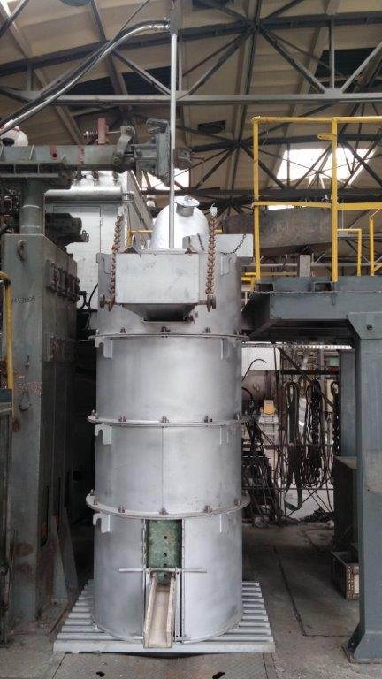
Pilot TSL furnace – Łukasiewicz-IMN
A new experimental TSL furnace with a capacity of 200 kg of slag has a circular cross-section with an outer diameter of 1,0 m, the inner diameter of 0.43 m, and a working height of 1.10 m.
The furnace is heated with a vertical coaxial pipe through which an oil as a fuel by inner pipe and an air by outer pipe are supplied. The lance can be used to supply 250 Nm³/h of compressed air and light heating oil with the capacity of 15 - 20 dm³/h.
Process gases are cooled down in a cooling chamber and then dedusted in a bag filter.

Slide 5
Lead slags
Studies of the transformation of three different types of waste slags into mineral resource with removing of heavy metals were performed in an oxidation-reduction process in a pilot TSL furnace:
Slag A from smelting of lead-bearing materials from copper metallurgy,
Slag B from battery paste smelting,
Synthetic slag C equivalent to the slag from primary/secondary lead concentrates smelting in the Queneau-Schuhmann-Lurgi (QSL) furnace.
Chemical composition of the lead slags [wt.-%]

Slide 6
Methodology
General slag smelting procedure in the pilot TSL furnace included the stages:
Oxidative-reductive or reductive smelting of the slag at 1200 °C for 4 hours (oxidation of MeS from matte and reduction of MeO from slag),
Reduction and fuming of the slag at 1250-1300 °C for 1-5 hours (extraction of copper into matte and fuming of Zn and Pb),
Oxidation of gas (CO, H₂) and metal vapours in the upper gaseous space of furnace,
Gas cooling and dedusting,
Matte and slag tapping,
The overall melting procedure was applied for slags A and B, which contain high levels of metal sulphides, especially FeS and Na₂S.
During the processing of slag C, the first operation was the reductive smelting, followed by the slag fuming.

Slide 7
Methodology
Oxidative smelting:
2 FeS + 3 O₂ + SiO₂ ⇔ 2 FeO*SiO₂ + 2 SO₂
Na₂S + 3/2 O₂ + SiO₂ ⇔ Na₂O*SiO₂ + SO₂
ZnS + 3/2 O₂ ⇔ ZnO + SO₂
ZnS(s) + O₂ ⇔ Zn(g) + SO₂
PbS + 3/2 O₂ ⇔ PbO + SO₂
MeS +3 Fe₃O₄ ⇔ MeO + 9 FeO + SO₂
Reduction and fuming:
C(s) + CO₂(g) ⇔ 2 CO(g)
MeO(l) + CO(g) ⇔ Me(g, l) + CO₂(g)
The unreduced residue is subjected to correction of chemical composition by melting of silica to produce silicate slag, containing 35-40 % of SiO₂, characterized by low content and low leachability of heavy metals.

Slide 8
Results
Optimal process parameters of the lead slags smelting in TSL furnace

Slide 9
Results
Lead and zinc content in slag during smelting and reduction of the slag A in TSL furnace. Trial 7

Slide 10
Results
Metals content in slag during smelting and reduction of the slag B in TSL furnace. Trial 8

Slide 11
Results
Metals content in slag during smelting and reduction of the slag C in TSL furnace. Trial 7

Slide 12
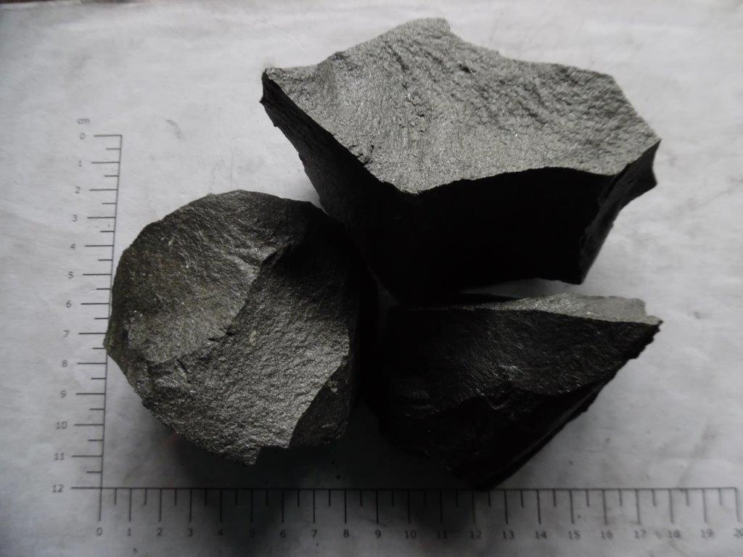
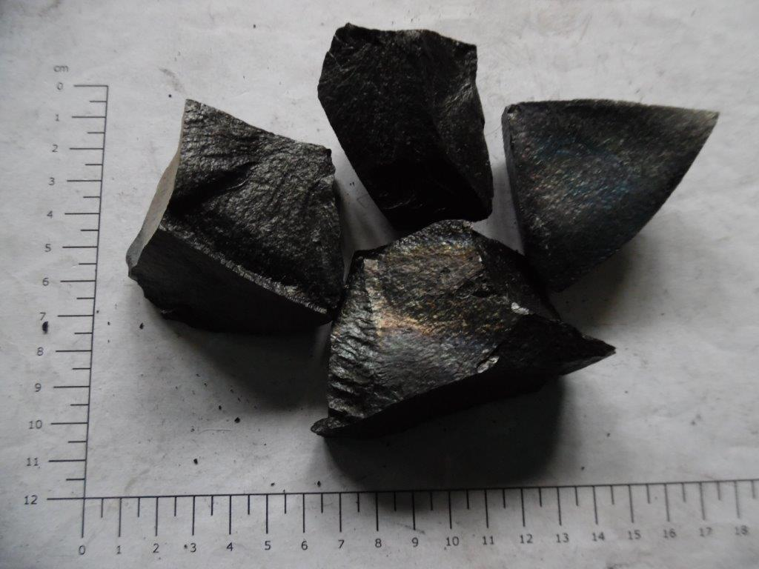
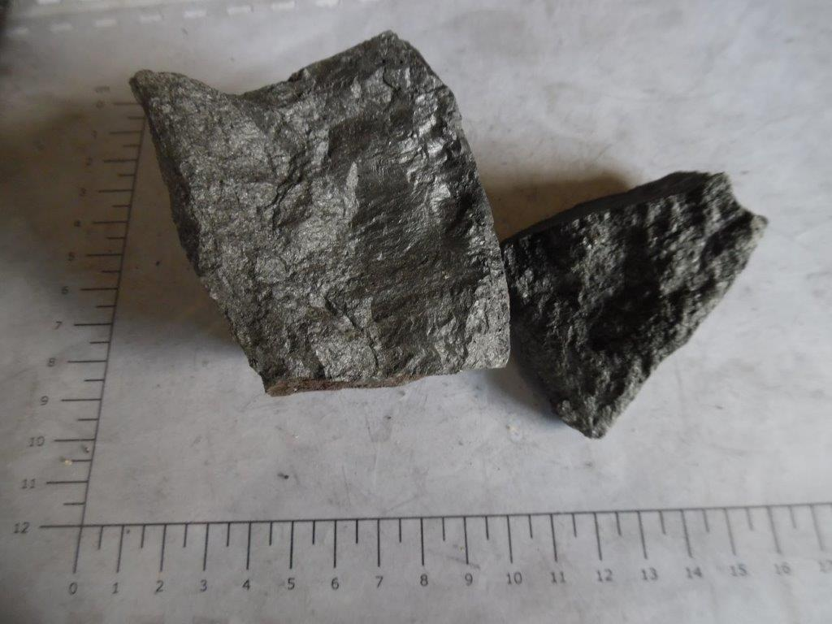
Results
The products of lead slag cleaning in a pilot TSL furnace include the recovered metals like Zn-Pb dust and copper matte as well as an inert silicate slag.
Chemical composition of the cleaned slags [wt.-%]
The final content of non-ferrous metals in the slag decreased with increasing process temperature, addition of the reducer and the reduction time, and, during the most successful tests, reached the values of (wt.-%): <0.1 % Pb, <0.01 % As, 0.01-0.1 % Sb, 0.02-0.2 % Sn, 0.1-0.6 % Zn.
Cleaned silicate slag
Slag A
Slag B
Slag C

Slide 13
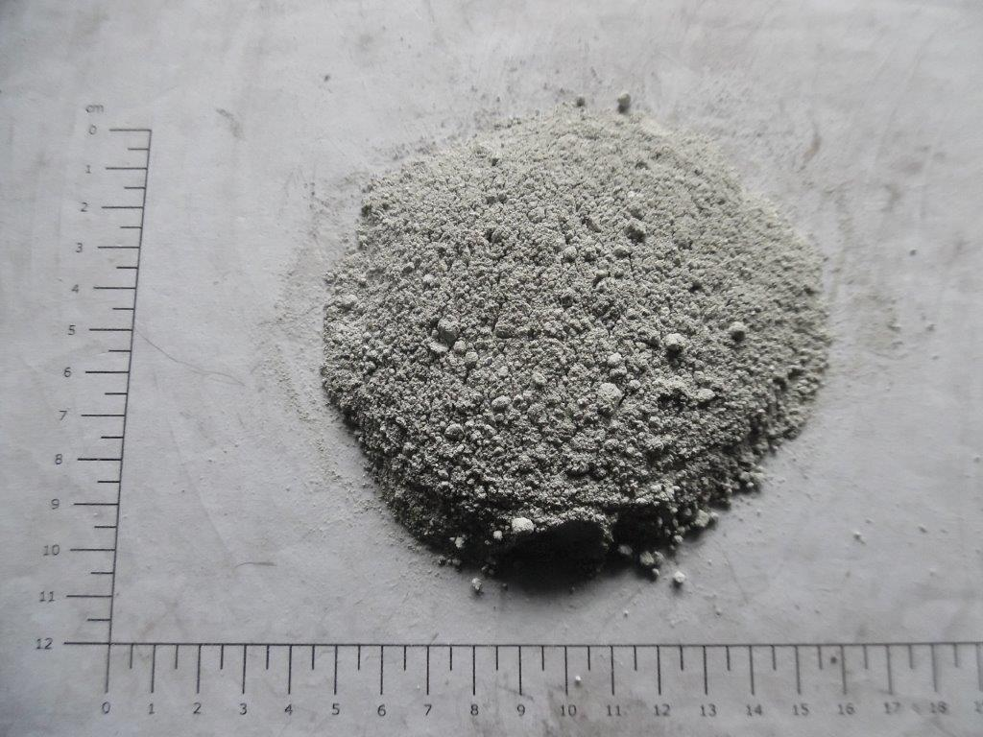
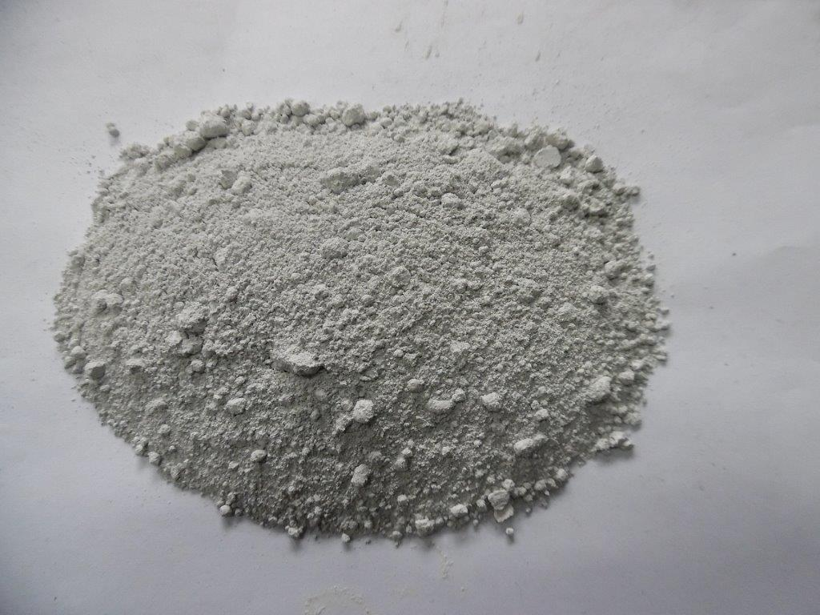
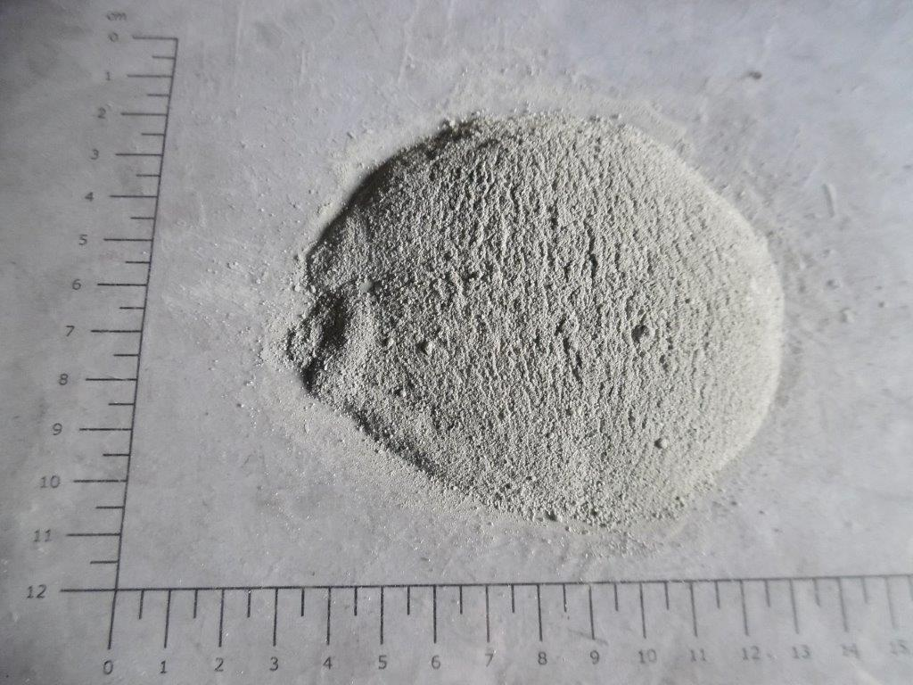
Results
In the process of smelting and fuming of the slags, the dusts containing volatile metal oxides and sulfates (Pb, Zn, Sb, As, Sb, Sn) and alkali evaporated from the slags were generated.
Chemical composition of the dust [wt.-%]
Dust from slag smelting
Dust (Slag A)
Dust (Slag B)
Dust (Slag C)

Slide 14
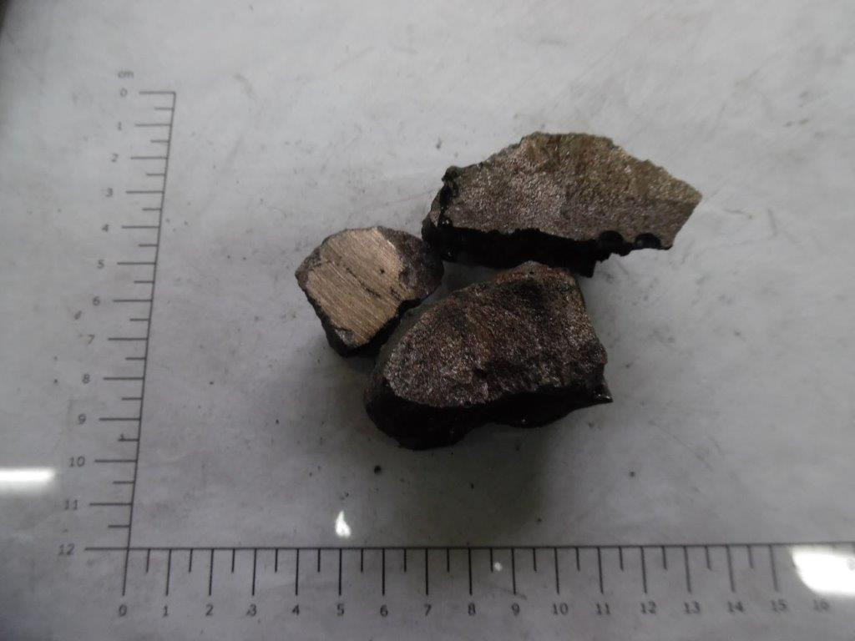
Results
Metal sulphides (FeS, ZnS, PbS, Na₂S) were oxidized in the oxidative-reductive smelting process in order to produce copper matte.
However, due to the low sulphides and copper content in the slags B and C, copper matte was obtained only for slag A processing.
Chemical composition of the copper matte [wt.-%]
Copper matte from slag A smelting

Slide 15
Results
The metallurgical balance for slags processing in a TSL furnace shows, that, at the optimal process parameters, it is possible to obtain a high yield od heavy metals in the dusts: 99 % Pb, 80-98 % Zn, 75-95 % Sn and 65-82 % Sb.
Recovery of metals in dust [%]

Slide 16
Results
The optimal process conditions (oxygen excess ratio to the lance, addition of reducing agent and high process temperature) provided possibilities for extraction of copper into matte and removal of zinc, lead and other volatile metals to dusts.
The unreduced substances were transferred into silica slag of FeO - CaO (Na₂O) - SiO₂ type, which has low content of heavy metals.
This indicates the possibility for their economic use in the construction industry.

Slide 17
Conclusions
The study showed that the TSL furnace is an appropriate reactor to conduct technologically effective process of oxidation - reduction smelting of polymetallic and multiphase slags, providing possibilities for:
Recovery of copper in copper matte,
High recovery of zinc and lead as well as other volatile metals (As, Sb, Sn) in dusts,
Transformation of unreduced remaining material into cleaned silicate slag of low heavy metals content (wt.-%): <0.1 % Pb, <0.01 % As, 0.01-0.1 % Sb, 0.02-0.2 % Sn, 0.1-0.6 % Zn,
Transfer of majority of sulfur to gases (in a form of SO₂) – which requires application of desulfurization process, especially for slags A and B.

Slide 18
Acknowledgements
This work was done in the framework of the European Institute of Innovation & Technology (EIT) Raw Materials SlagVal project titled “Slag valorisation for multi metal recovery and mineral resource production” (project agreement No. 17181).

Slide 19
Thank you for your attention

